Slide 1
JUDGE FROG
COMPREHENSIVE HUMAN TRAFFICKING DATA
SEARCH AND ANALYSIS
Brice Boula, Collin Duncan,
David Tomlinson, Landon Westrom
TCU Computer Science
Senior Capstone Project 2014-2015
Final Presentation
Notes:
Mention Senior Design Capstone project in presentation
Intro video : https://youtu.be/J4ztDU-yr74

Slide 2
Human Trafficking Facts
600 to 800 thousand people across international borders annually
80% female
50% children
One of the most profitable criminal activities worldwide
Gross violation of human rights
Need for studies to understand and address problem
Notes:
Landon

Slide 3
Background
NIJ grant awarded to TCU professors
Goals of grant for project
Publicly available centralized database of HT data
Support study for government, NGOs, researchers, etc.
Professors approached TCU CS of summer 2014
Student project possibilities
Selected for 1 of 3 senior capstone projects
Notes:
Landon
That could lead to three answers to this problem.
1. How interconnected are these Organized crime groups involved in these crimes
2. What types of Organized crime groups take part in human trafficking
3. What is the possibility to prevent human trafficking

Slide 4
Topics
Project Requirements
Development Process
System Overview
Database Structure
Technologies Used
Web Application
Results/Challenges/Conculsion
Notes:
Landon

Slide 5
Project Requirements
Create database for trafficking data
Web application to interface with database
Analyze data with charts
Provide data management for client
Notes:
Landon

Slide 6
Development Process
Fall 2014 Semester
Project Definition
Requirements Gathering and Prototyping
Initial Design
Spring 2015 Semester
Judge Frog Web Application Development
User Acceptance Testing
Presentations
Project Deployment
Notes:
Brice

Slide 7
Fall 2014 Semester
Project Defined
Initial Meetings with Clients
Early Versions of Documentation
Project Plan
Initial Requirements
Initial Design
Iteration 1
Complete Project Database
Upload to database via prototype
Website Skeleton Complete
Complete Documents
Notes:
Brice

Slide 8
Spring 2015 Semester
Iteration 2
Web application completed
Web application integration test development has begun
Website design finalized
First round of analytics prototyped
Iteration 3
Second round of analytics prototyped
Analytics finalized
Iteration 4
Finish all testing
Notes:
Brice

Slide 9
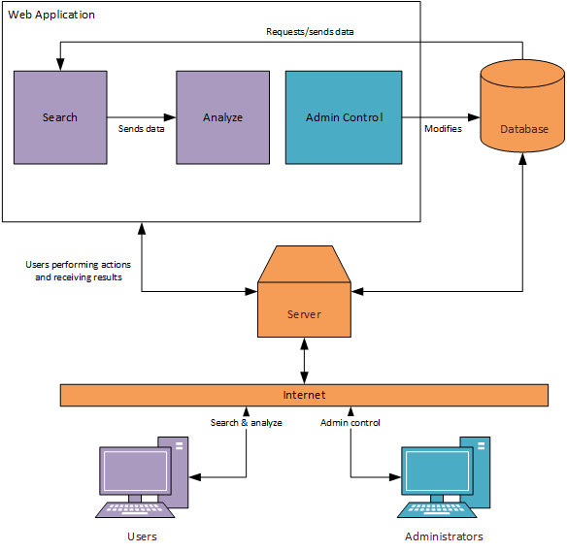
System Overview
Notes:
Brice

Slide 10
Database
Developed using MySQL5
MySQL Workbench
Stores denormalized case information
Conforms to client standard
Notes:
Collin

Slide 11
Database
Case
Judge
Victims
Defendant
Organized Crime Involvement
Arrest Details
Charge Details
Sentencing Details
Variable Name | Type
Name | VARCHAR
Number | VARCHAR
Number of Defendants | INT
State | VARCHAR
Federal District Location | VARCHAR
Federal District Number | INT
Summary | TEXT
Type | INT
Variable Name | Type
Name | VARCHAR
Gender | BOOLEAN
Race | INT
Tenure | YEAR
Appointed By | BOOLEAN
Variable Name | Type
Total | INT
Female | INT
Foreign | INT
Minor | INT
Variable Name | Type
First Name | VARCHAR
Last Name | VARCHAR
Alias | TEXT
Gender | BOOLEAN
Race | INT
Birthdate | YEAR
Arrest Age | INT
Variable Name | Type
Name | VARCHAR
Race | INT
Scope | INT
Size | INT
Variable Name | Type
Date of Arrest | DATE
Detained | BOOLEAN
Bail Type | INT
Bail Amount | INT
Variable Name | Type
Date of Charge | DATE
# Felonies Charged | INT
Counts per Statute | INT
Pleas per Statute | INT
Trials per Statute | INT
Fines per Statute | INT
Sentencing per Statute | INT
Probation per Statute | INT
Variable Name | Type
Date of Sentence | DATE
Date of Sentence Termination | DATE
# Felonies Sentenced | INT
# Months Sentenced | INT
Restitution | INT
Asset Forfeiture | BOOLEAN
# Months Probation | INT
Notes:
Collin

Slide 12
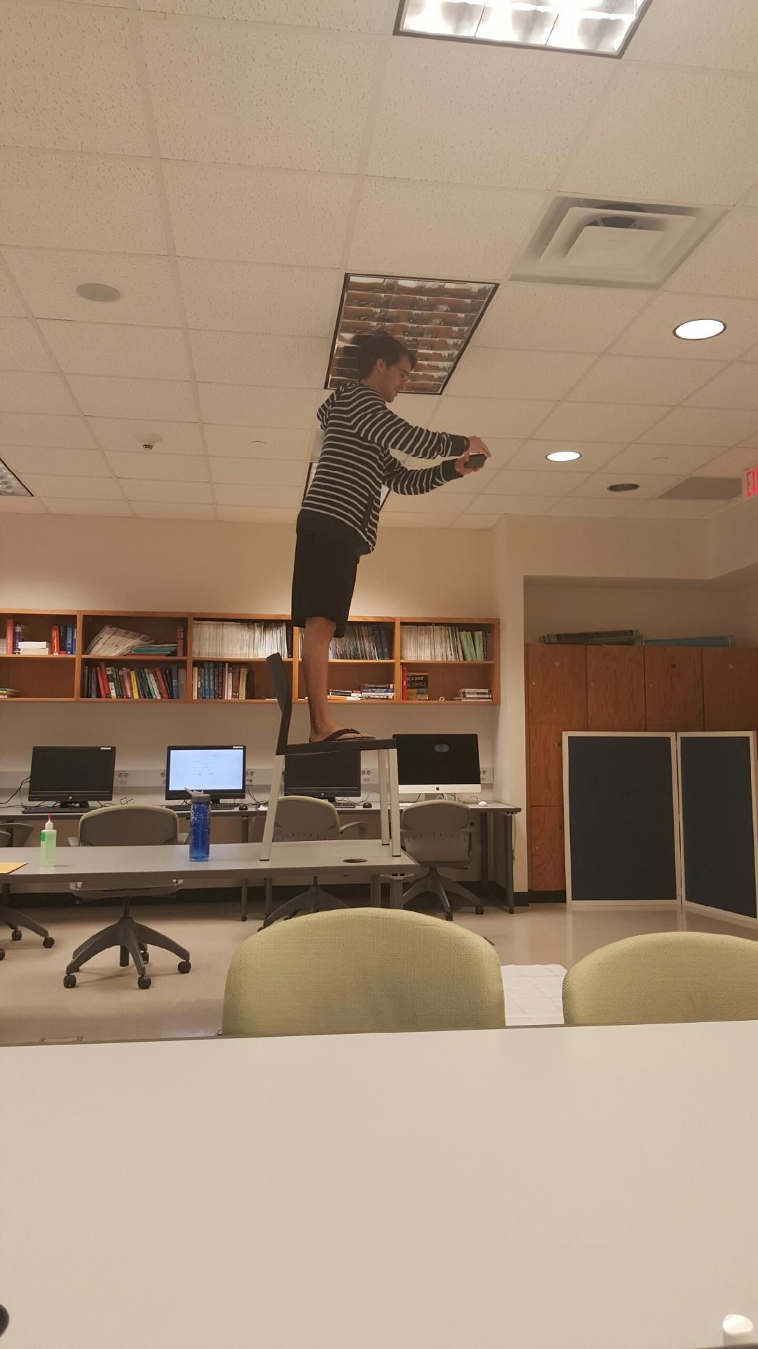
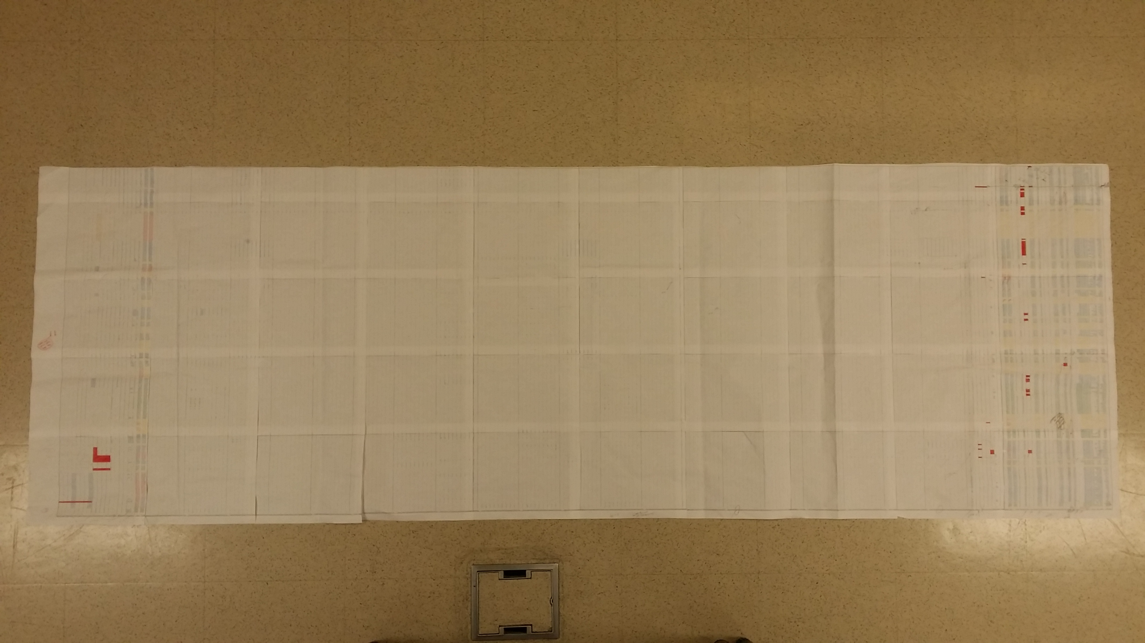
Database
5pt font
7ft long
50 sheets of paper
1 roll of tape
1 table
1 chair
1 professor leaving the room

Slide 13
Why MySQL?
Scalability, flexibility, and performance
Availability from web hosting providers
MySQL Workbench
Notes:
Collin

Slide 14
Web Application
Developed using:
PHP
CakePHP Framework
Javascript + JQuery
Google Charts
Bootstrap
Comprised of three sections
Notes:
Brice

Slide 15

Why PHP/CakePHP?
PHP
Popular
Flexible
MySQL
Available for Windows and *nix
CakePHP
MVC framework
Simple configuration
Built-in securities
Notes:
Brice

Slide 16
Web Application
Admin Panel
Search
Analyze
maintains
refines
visualizes
Notes:
Brice
- Here are the basic functions

Slide 17
Admin Panel
Maintain database and users
Two classes of users:
Admin: full permissions
Research Assistant (RA): insert/edit permissions
Case insertion
Single-case
Batch upload (admin only)
Case review
Administrators verify inserted/updated data
Notes:
David

Slide 18
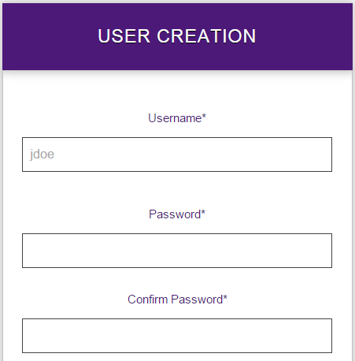
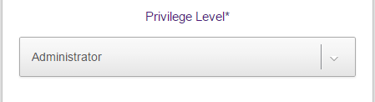
User Management

Slide 19
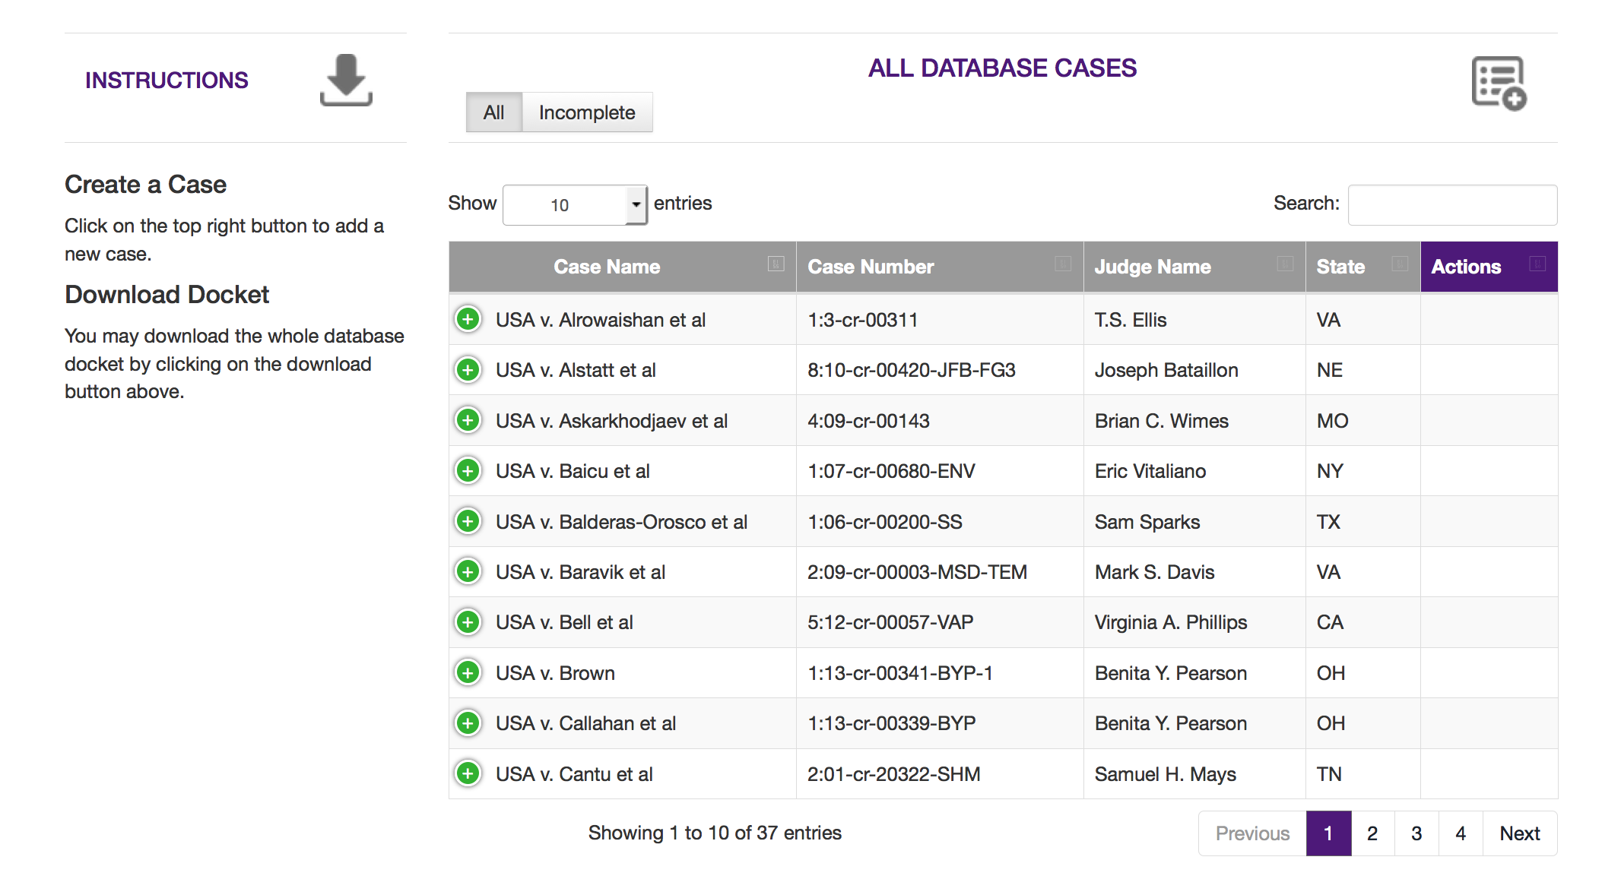
Case Creation

Slide 20
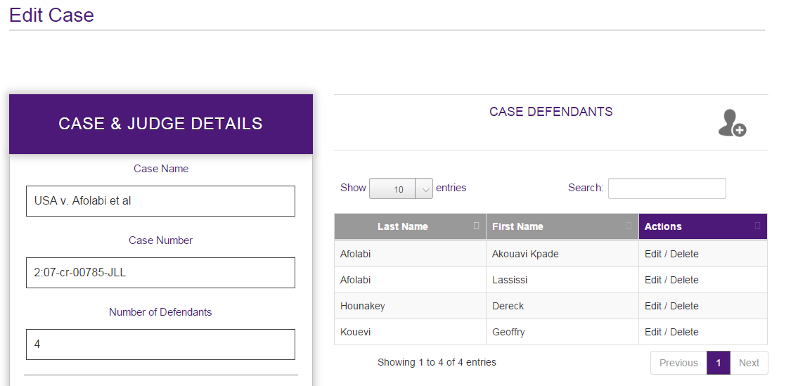
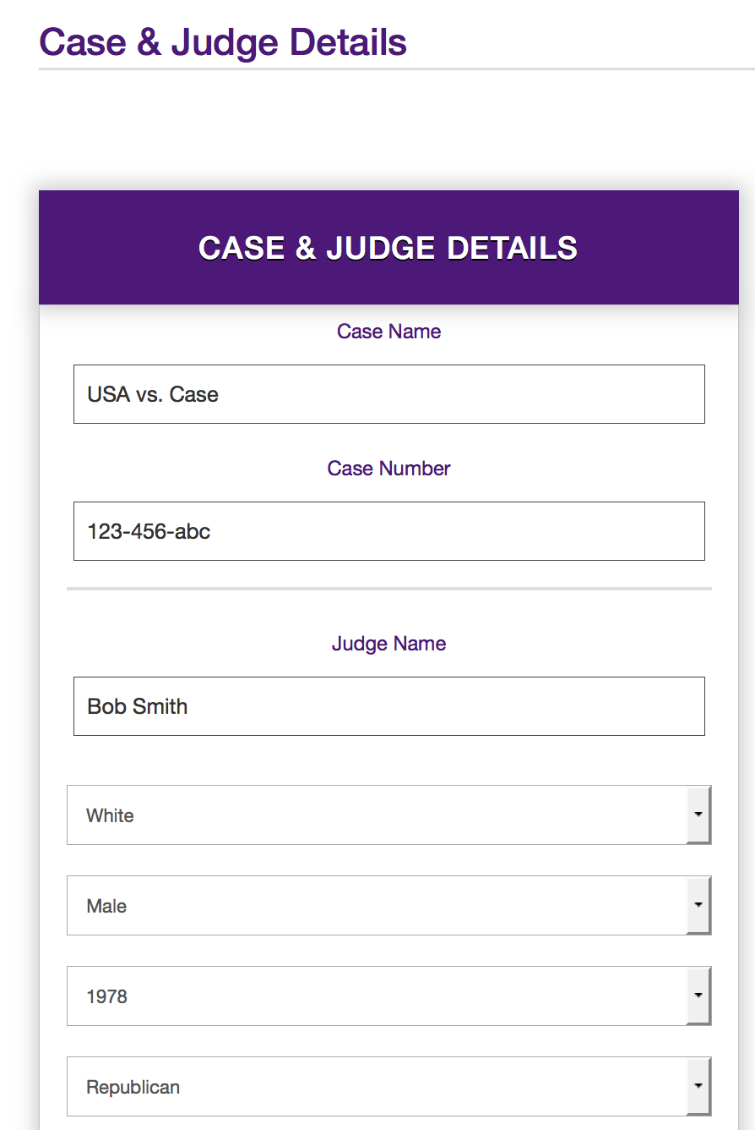
Case Creation

Slide 21
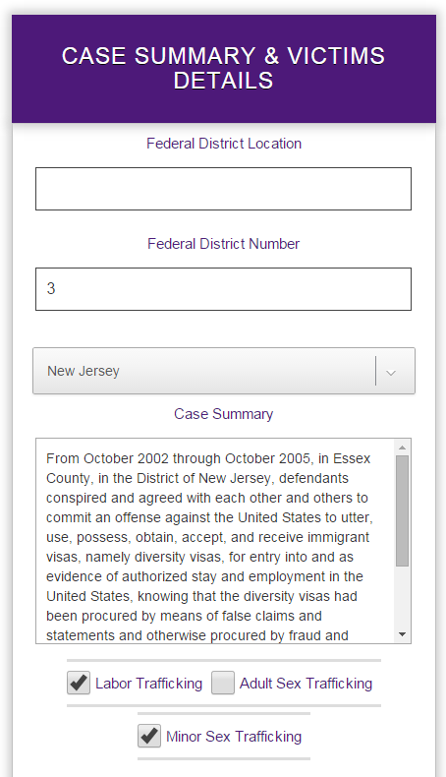
Case Creation

Slide 22
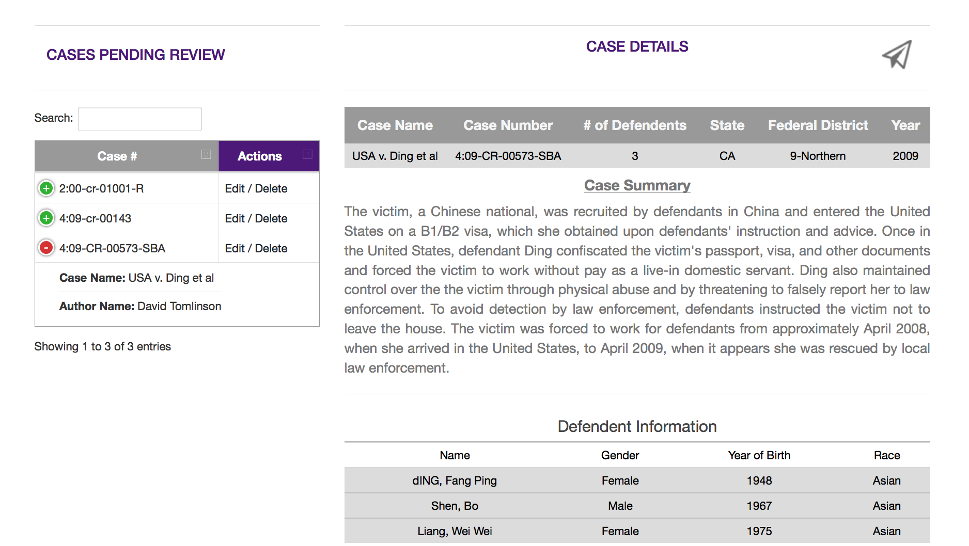
Case Review

Slide 23
Search
47 variables in 9 categories
Displays results of search in table
Each row displays modal with more details
Modal contains visible filtering function
Displays most relevant data first
Option to display all data
Notes:
David

Slide 24
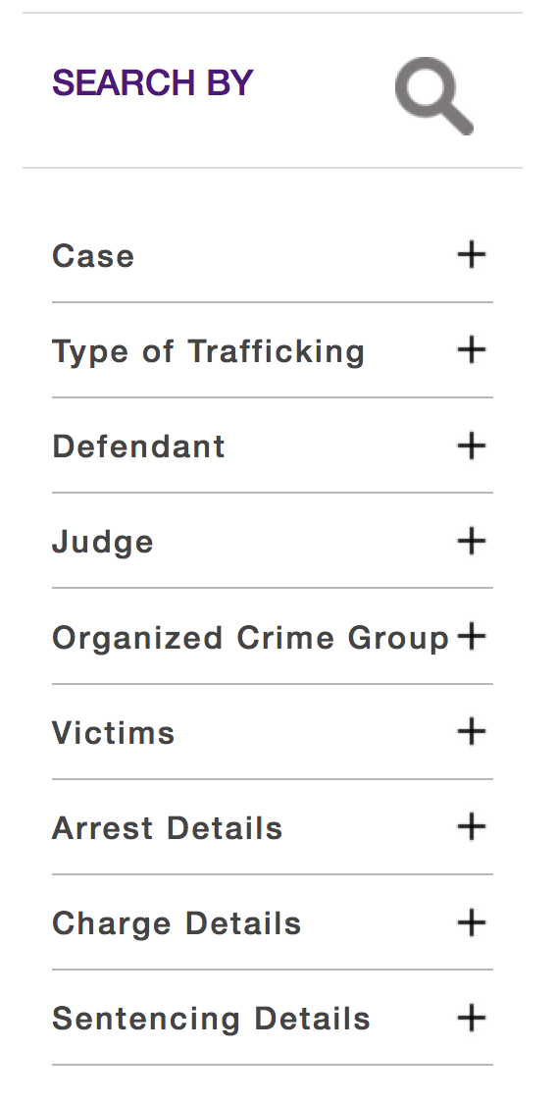
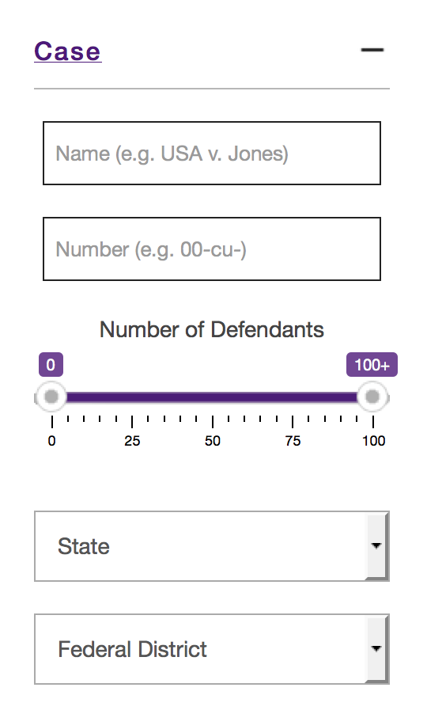
Search Criteria

Slide 25
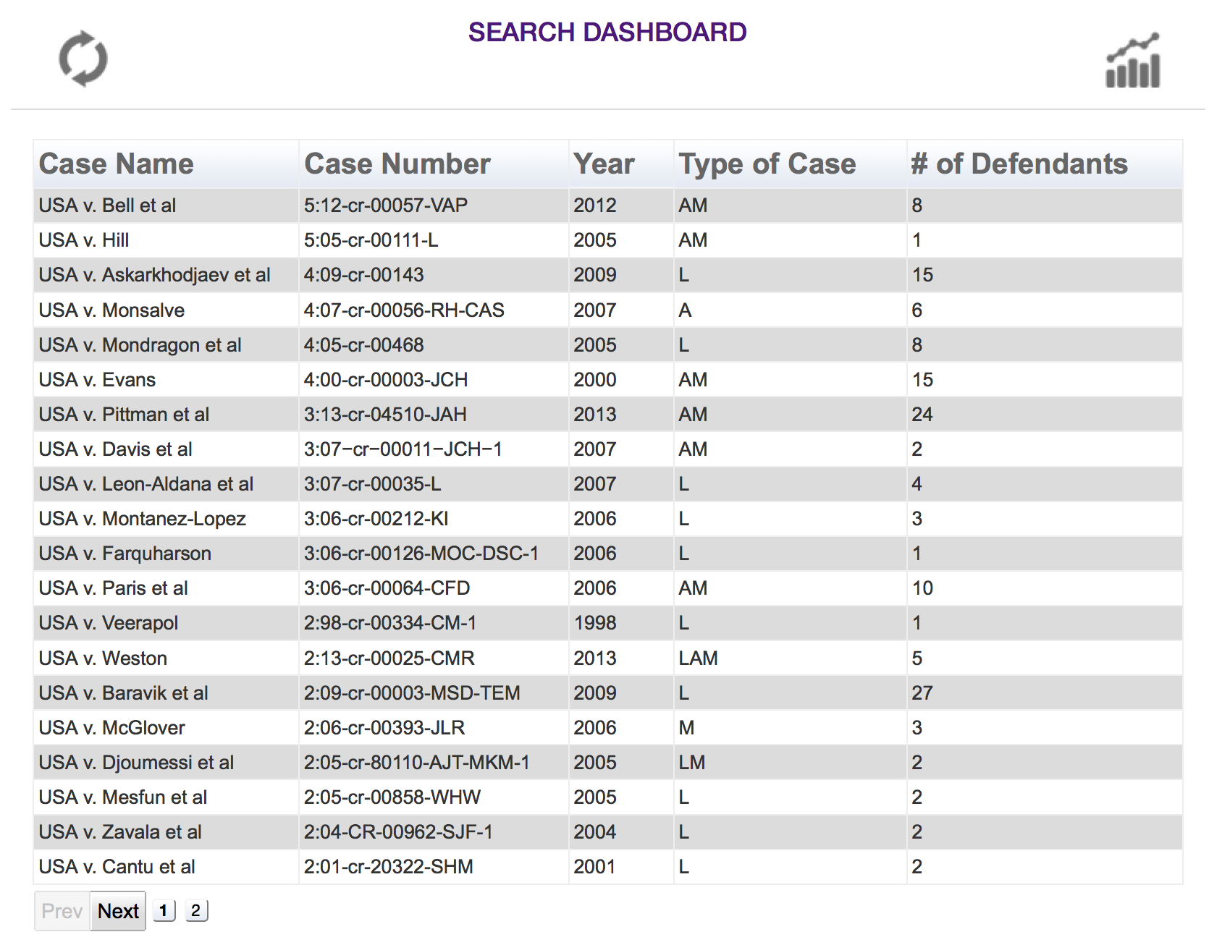
Search Results

Slide 26
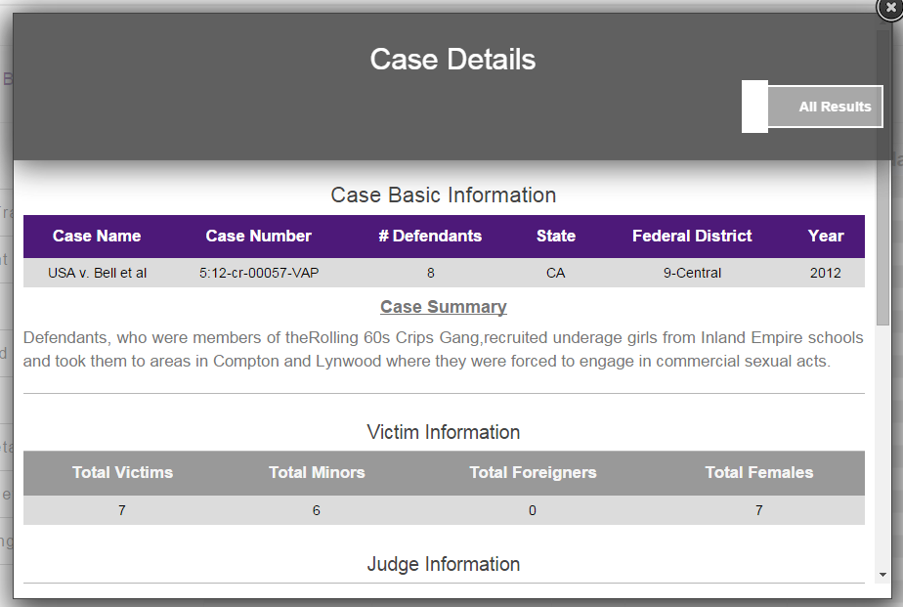
Search Results

Slide 27
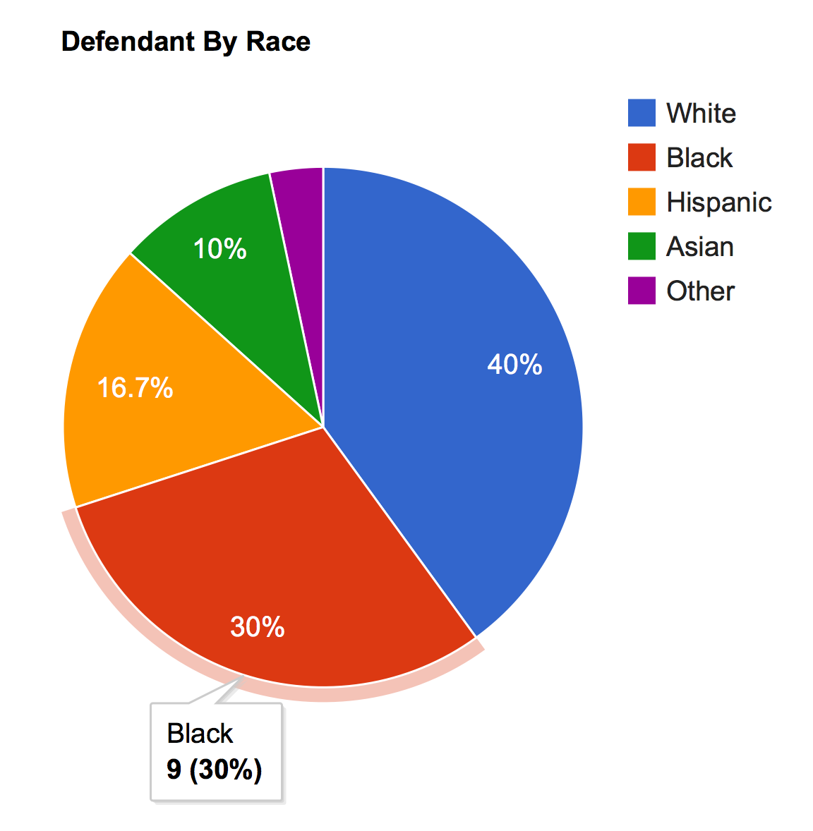
Analyze
Visualize data received from Search
5 types of graphs
Line
Bar
Histogram
Pie
Geographic
Multiple independent and dependent options
Notes:
David

Slide 28
Data Flow
Admin Control Panel
Single Insert
Review
Edit
Batch Upload
Download
Admin
Data In Progress
Data
User Application
Search
Analyze
User
Notes:
Collin

Slide 29
Results
Developed resource for accessing human trafficking information
Implemented dynamic graphing solution to visualize data
Provided project administrators with ability to:
Maintain dataset
Manage users
Notes:
Landon

Slide 30
Challenges
Client Communication
Originally had two clients
One initiated the project without other’s knowledge
Now we have one client
Lack of Requirements
Web application features
Finalized schema for data
Acquiring Testable Data
3rd party contractor failed to deliver to client
Continually plagued with errors
Notes:
Landon

Slide 31
Conclusion
Need for more self-reliance to create requirements
Determine more strict deadlines for clients and team
Prototype, prototype, prototype
Effective communication leads to effective results
Leave more room for testing
Gained team experience working on high-profile project
Notes:
Landon

Slide 32

A Few Words From Our Client

Slide 33
Questions

